Slide 1
Introduction to Information Retrieval
Lecture 2: Text Representation
Slides source (partly):
http://nlp.stanford.edu/IR-book/newslides.html

Slide 2
Definition
Information Retrieval (IR) is finding information (usually documents) of an unstructured nature (usually text) that satisfies an information need from within large collections (usually stored on computers).
  databases and
  the World Wide Web
There is overlap in the usage of the terms:
information / data / document / text retrieval

Slide 3
Overview
An information retrieval process begins when a user enters a query into the system. Queries express information needs
  search strings in web search engines.
User queries are matched to objects stored in the database:
  text documents,
  images or videos.
Most IR systems compute a numeric score on how well each object in the database match the query, and rank the objects according to this value. The top ranking objects are then shown to the user.

Slide 4
Query example
Which plays of Shakespeare contain the words Brutus AND Caesar but NOT Calpurnia?
One could grep all of Shakespeare’s plays for Brutus and Caesar, then strip out lines containing Calpurnia?
  Slow (for large corpora)
  NOT Calpurnia is non-trivial
  Other operations (e.g., find the word Romans near countrymen) not feasible
  Ranked retrieval (best documents to return)
    Later lectures

Slide 5
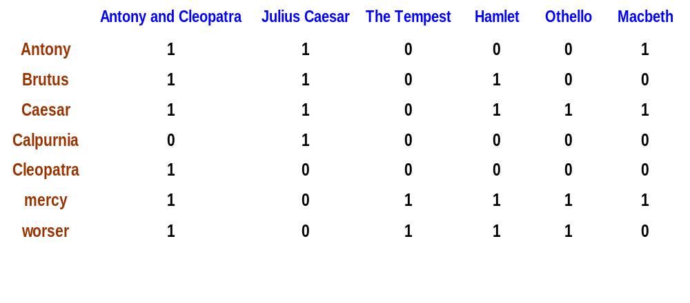
Term-document incidence
1 if play contains word, 0 otherwise
Brutus AND Caesar but NOT Calpurnia

Slide 6
Incidence vectors
So we have a 0/1 vector for each term.
To answer query: take the vectors for Brutus, Caesar and Calpurnia (complemented) ➔ bitwise AND.
110100 AND 110111 AND 101111 = 100100.
Antony and Cleopatra
Hamlet

Slide 7
Answers to query
Antony and Cleopatra, Act III, Scene ii
Agrippa [Aside to DOMITIUS ENOBARBUS]: Why, Enobarbus,
When Antony found Julius Caesar dead,
He cried almost to roaring; and he wept
When at Philippi he found Brutus slain.
Hamlet, Act III, Scene ii
Lord Polonius: I did enact Julius Caesar I was killed i' the
Capitol; Brutus killed me.

Slide 8
Bigger collections
Consider N = 1M documents, each with about 1K terms.
Avg 6 bytes/term including spaces/punctuation
  6GB of data in the documents. (1M*1K*6)
Say there are m = 500K distinct terms among these.

Slide 9
Can’t build the matrix
500K x 1M matrix has half-a-trillion 0’s and 1’s.
But it has no more than one billion 1’s (1K*1M).
  matrix is extremely sparse.
What’s a better representation?
  We only record the 1 positions.
Why?
0.2%

Slide 10
Inverted index
For each term T, we must store a list of all documents that contain T.
Do we use an array or a list for this?
Brutus
2
4
8
16
32
64
128
Calpurnia
1
2
3
5
8
13
21
34
Caesar
13
16
What happens if the word Caesar is added to document 14?

Slide 11
Inverted index
Linked lists generally preferred to arrays
  Dynamic space allocation
  Insertion of terms into documents easy
  Space overhead of pointers
Posting
Brutus
2
4
8
16
32
64
128
Calpurnia
1
2
3
5
8
13
21
34
Caesar
13
16
Dictionary
Postings lists
Sorted by docID (more later on why).

Slide 12





Inverted index construction
Documents to
be indexed.
Friends, Romans, countrymen.
Regular expression
Tokenizer
Token stream.
Friends
Romans
Countrymen
More on
these later
Linguistic modules
Modified tokens.
friend
roman
countryman
Indexer
friend
2
4
roman
1
2
Inverted index.
countryman
13
16

Slide 13
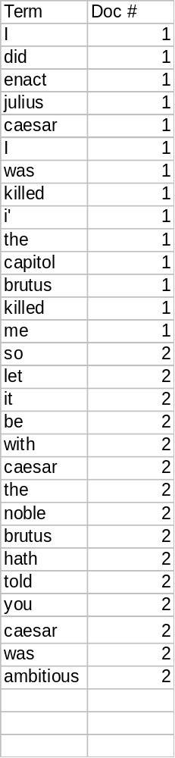
Indexer steps
Sequence of (Modified token, Document ID) pairs.
Doc 1
Doc 2
I did enact Julius
Caesar I was killed
i' the Capitol;
Brutus killed me.
So let it be with
Caesar. The noble
Brutus hath told you
Caesar was ambitious

Slide 14

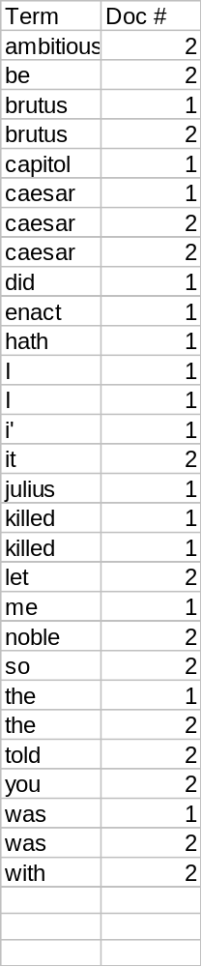
Sort by terms.
Core indexing step.

Slide 15


Multiple term entries in a single document are merged.
Frequency information is added.
Why frequency?
Will discuss later.

Slide 16
Where do we pay in storage?
Sec. 1.2
Lists of docIDs
Terms and counts
Later in the course:
How do we index efficiently?
How much storage do we need?
Pointers

Slide 17
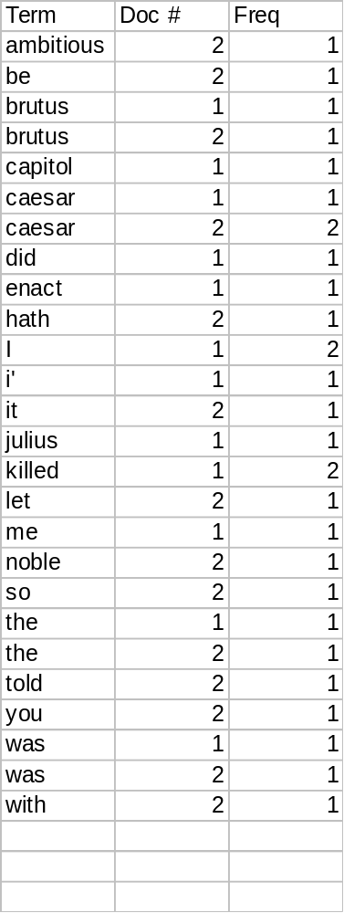
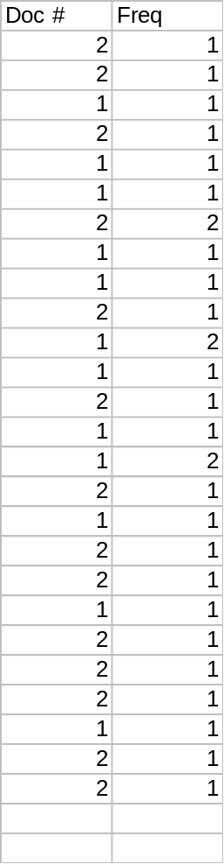
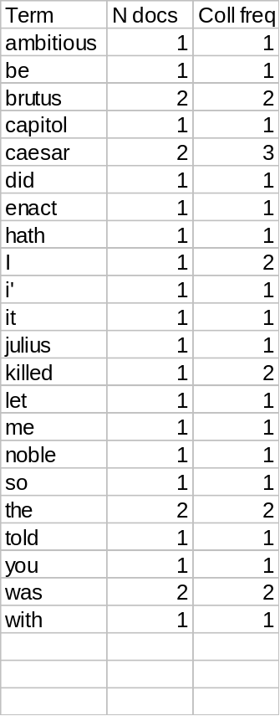
The result is split into a Dictionary file and a Postings file.

Slide 18
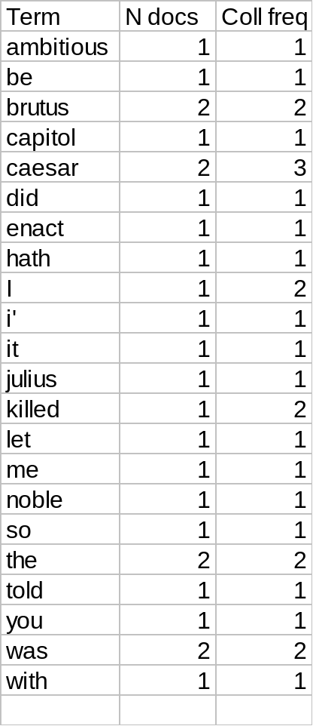
Where do we pay in storage?
Terms
Pointers

Slide 19
The index we just built
Today’s focus
How do we process a query?
  Later - what kinds of queries can we process?

Slide 20
Query processing: AND
Consider processing the query:
  Brutus AND Caesar
  Locate Brutus in the Dictionary;
    Retrieve its postings.
  Locate Caesar in the Dictionary;
    Retrieve its postings.
  “Merge” the two postings:
2
4
8
16
32
64
128
Brutus
1
2
3
5
8
13
21
34
Caesar

Slide 21
The merge
Walk through the two postings simultaneously, in time linear in the total number of postings entries
2
2
4
4
8
8
16
16
32
64
128
32
64
128
Brutus
2
8
1
Caesar
1
2
2
3
5
5
8
8
13
13
21
21
34
3
34
If the list lengths are x and y, the merge takes O(x+y)
operations.
Crucial: postings sorted by docID.

Slide 22

Intersecting two postings lists
(a “merge” algorithm)

Slide 23
Boolean queries: Exact match
The Boolean Retrieval model is being able to ask a query that is a Boolean expression:
  Boolean Queries are queries using AND, OR and NOT to join query terms
    Views each document as a set of words
    Is precise: document matches condition or not.
Primary commercial retrieval tool for 3 decades.
Professional searchers (e.g., lawyers) still like Boolean queries:
  You know exactly what you’re getting.
  Search systems: Email, library catalog

Slide 24
Boolean queries:
More general merges
Exercise: Adapt the merge for the queries:
Brutus AND NOT Caesar
Brutus OR NOT Caesar
Can we still run through the merge in time O(x+y)?
What can we achieve?

Slide 25
Merging
What about an arbitrary Boolean formula?
(Brutus OR Caesar) AND NOT
(Antony OR Cleopatra)
Can we always merge in “linear” time?
  Linear in what?
Can we do better?

Slide 26
Query optimization
What is the best order for query processing?
Consider a query that is an AND of t terms.
For each of the t terms, get its postings, then AND them together.
Brutus
2
4
8
16
32
64
128
Calpurnia
1
2
3
5
8
16
21
34
Caesar
13
16
Query: Brutus AND Calpurnia AND Caesar

Slide 27
Query optimization example
Process in order of increasing frequency:
  start with smallest set, then keep cutting further.
This is why we kept
freq in dictionary
Brutus
2
4
8
16
32
64
128
Calpurnia
1
2
3
5
8
13
21
34
Caesar
13
16
Execute the query as (Caesar AND Brutus) AND Calpurnia.

Slide 28
More general optimization
e.g., (madding OR crowd) AND (ignoble OR strife)
Get freq’s for all terms.
Estimate the size of each OR by the sum of its freq’s (conservative).
Process in increasing order of OR sizes.

Slide 29
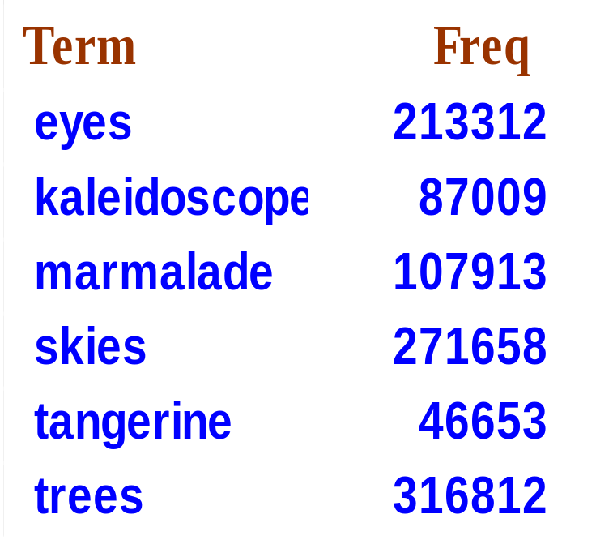
Exercise
Recommend a query processing order for
(tangerine OR trees) AND
(marmalade OR skies) AND
(kaleidoscope OR eyes)

Slide 30
Query processing exercises
If the query is friends AND romans AND (NOT countrymen), how could we use the freq of countrymen?
Exercise: Extend the merge to an arbitrary Boolean query. Can we always guarantee execution in time linear in the total postings size?
Hint: Begin with the case of a Boolean formula query: in this, each query term appears only once in the query.

Slide 31
What’s ahead in IR?
Beyond term search
What about phrases?
  Stanford University
Proximity: Find Gates NEAR Microsoft.
  Need index to capture position information in docs. More later.
Zones in documents: Find documents with (author = Ullman) AND (text contains automata).

Slide 32
Evidence accumulation
1 vs. 0 occurrence of a search term
  2 vs. 1 occurrence?
  3 vs. 2 occurrences, etc.?
  Usually more seems better
Need term frequency information in docs

Slide 33
Ranking search results
Boolean queries give inclusion or exclusion of docs.
Often we want to rank/group results
  Need to measure proximity from query to each doc.
  Need to decide whether docs presented to user are singletons, or a group of docs covering various aspects of the query.

Slide 34
About the course (IR track)
חובות הקורס:
  נוכחות בהרצאות חובה
  הגשה [והגנת] פרויקט: נצגה בכיתה
בחינות:
  בחינה סופית
חישוב הציון הסופי:
  ציון עובר (56) בבחינה, בעבודות ובפרויקט
  הציון הסופי משוקלל על פי:
    ציון הפרויקט: 25%
    ציון העבודות הגשה: 25%
    ציון הבחינה: 40%
    נוכחות בכיתה: 10%

Slide 35
About the course (MSc degree)
חובות הקורס:
  נוכחות והשתתפות בהרצאות: 80% לפחות
  הגשת פרויקט
בחינות:
  הגנת פרויקט (מצגת בכיתה)
חישוב הציון הסופי:
  ציון עובר בקורס – 65
  הציון הסופי משוקלל על פי:
    ציון פרויקט: 90%: ציון הגשה (50%)+ הגנה (מצגת בכיתה, 50%)
    השתתפות בכיתה: 10%

Slide 36
Main subjects
איחזור בולאני (Boolean retrieval, chapter 1)
אוצר מילים ((Term vocabulary, chapter 2
מילונים ((Dictionaries, chapter 3
בניה ודחיסת האינדקסים (Index construction and compression, chapters 4-5)
מודלים ווקטוריים (Vector Space Model, chapter 6)
דירוג מסמכים במערכות חיפוש (Scoring and ranking in a search system, chapter 7)
מדדים לאיחזור Evaluation in IR: Precision vs. Recall, chapter 8) )
מודלים הסתברותיים (Probabilistic Retrieval, chapter 11)
אלגוריטמים לסיווג אינפורמציה טקסטואלית (Text Classification, chapters 13-15)
אלגוריטמים לקיבוץ אינפורמציה טקסטואלית ((Text Clustering, chapters 16-17
אלגוריתם לדירוג אתרים (Link analysis, PageRank Algorithm, chapter 21)

Slide 37
About the homeworks (IR track)
4 stages (HWs):
  Normalize textual data and build a TR model
  Implement Text Retrieval task
  Implement clustering task
  Implement classification task
Frontal checking (last week)

Slide 38
About the final project (MSc deg)
4 stages (HWs):
  Normalize textual data and build a TR model
  Implement Text Retrieval task
  Implement clustering task
  Implement classification task
  Advanced topic: DL, link analysis, signal processing, etc.
Frontal checking (last week)

Slide 39
FASTER POSTINGS MERGES:
SKIP POINTERS/SKIP LISTS

Slide 40
Recall basic merge
Sec. 2.3
Walk through the two postings simultaneously, in time linear in the total number of postings entries
2
4
8
41
48
64
128
Brutus
2
8
1
2
3
8
11
17
21
31
Caesar
If the list lengths are m and n, the merge takes O(m+n)
operations.
Can we do better?
Yes (if index isn’t changing too fast).

Slide 41
Augment postings with skip pointers (at indexing time)
Sec. 2.3
41
128
2
4
8
41
48
64
128
11
31
1
2
3
8
11
17
21
31
Why?
To skip postings that will not figure in the search results.
How?
Where do we place skip pointers?

Slide 42
Query processing with skip pointers
Sec. 2.3
41
128
2
4
8
41
48
64
128
11
31
1
2
3
8
11
17
21
31
Suppose we’ve stepped through the lists until we process 8 on each list. We match it and advance.
We then have 41 and 11 on the lower. 11 is smaller.
But the skip successor of 11 on the lower list is 31, so
we can skip ahead past the intervening postings.

Slide 43
Where do we place skips?
Sec. 2.3
Tradeoff:
  More skips → shorter skip spans ⇒ more likely to skip. But lots of comparisons to skip pointers.
  Fewer skips → few pointer comparison, but then long skip spans ⇒ few successful skips.

Slide 44
Placing skips
Sec. 2.3
Simple heuristic: for postings of length L, use √L evenly-spaced skip pointers.
This ignores the distribution of query terms.
Easy if the index is relatively static; harder if L keeps changing because of updates.
This definitely used to help; with modern hardware it may not (Bahle et al. 2002) unless you’re memory-based
  The I/O cost of loading a bigger postings list can outweigh the gains from quicker in memory merging!

Slide 45
PHRASE QUERIES AND POSITIONAL INDEXES

Slide 46
Phrase queries
Sec. 2.4
Want to be able to answer queries such as “stanford university” – as a phrase
Thus the sentence “The inventor Stanford Ovshinsky never went to university” is not a match.
  The concept of phrase queries (in “”) has proven easily understood by users; one of the few “advanced search” ideas that works
  Many more queries are implicit phrase queries (like names, without “”)
For this, it no longer suffices to store only
<term : docs> entries

Slide 47
A first attempt: Biword indexes
Sec. 2.4.1
Index every consecutive pair of terms in the text as a phrase
For example the text “Friends, Romans, Countrymen” would generate the biwords
  friends romans
  romans countrymen
Each of these biwords is now a dictionary term
Two-word phrase query-processing is now immediate.

Slide 48
Longer phrase queries
Sec. 2.4.1
Reduction to conjunctive Boolean queries:
  stanford university palo alto can be broken into the Boolean query on biwords:
stanford university AND university palo AND palo alto
Without the docs, we cannot verify that the docs matching the above Boolean query do contain the phrase.
Can have false positives!

Slide 49
Extended biwords
Sec. 2.4.1
Parse the indexed text and perform part-of-speech-tagging (POST).
Bucket the terms into (say) Nouns (N) and articles/prepositions (X).
Call any string of terms of the form NX*N an extended biword.
  Each such extended biword is now made a term in the dictionary.
Example: catcher in the rye
  N X X N
Query processing: parse it into N’s and X’s
  Segment query into enhanced biwords and look up in the index: catcher rye

Slide 50
Issues for biword indexes
Sec. 2.4.1
False positives, as noted before
Reduction to boolean query does not work well:
  “cost overruns on a power plant” ->
  “cost overruns” AND “overruns power” AND “power plant”
Index blowup due to bigger dictionary
  Infeasible for more than biwords, big even for them
Biword indexes are not the standard solution (for all biwords) but can be part of a compound strategy

Slide 51
Solution 2: Positional indexes
Sec. 2.4.2
In the postings, store for each term the position(s) in which tokens of it appear:
  <term, number of docs containing term;
  doc1, term frequency in doc1: position1, position2 … ;
  doc2, term frequency in doc2: position1, position2 … ;
  etc.>

Slide 52

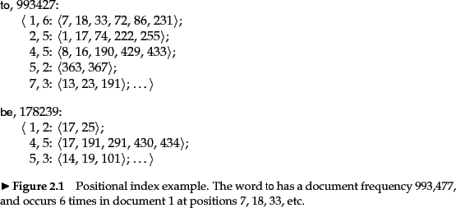
Example

Slide 53
Positional index example
Sec. 2.4.2
<be: 993427;
1,6: 7, 18, 33, 72, 86, 231;
2,5: 3, 149;
4,5: 17, 191, 291, 430, 434;
5,2: 363, 367, …>
Which of docs 1,2,4,5
could contain “to be
or not to be”?
For phrase queries, we use a merge algorithm recursively at the document level
But we now need to deal with more than just equality

Slide 54
Processing a phrase query
Sec. 2.4.2
Extract inverted index entries for each distinct term: to, be, or, not.
Merge their doc:position lists to enumerate all positions with “to be or not to be”.
  to:
    2:1,17,74,222,551; 4:8,16,190,429,433; 7:13,23,191; ...
  be:
    1:17,19; 4:17,191,291,430,434; 5:14,19,101; ...
Same general method for proximity searches

Slide 55
Positional index size
Sec. 2.4.2
Need an entry for each occurrence, not just once per document
Index size depends on average document size
  Average web page has <1000 terms
  SEC filings, books, even some epic poems … easily 100,000 terms
Consider a term with frequency 0.1%
Why?
Document size
Postings
Positional postings
1000
1
1
100,000
1
100

Slide 56
Rules of thumb
Sec. 2.4.2
A positional index is 2–4 as large as a non-positional index
Positional index size 35–50% of volume of original text
Caveat: all of this holds for “English-like” languages

Slide 57
Resources for today’s lecture
IIR 2
MG 3.6, 4.3; MIR 7.2
Porter’s stemmer: http://www.tartarus.org/~martin/PorterStemmer/
Skip Lists theory: Pugh (1990)
  Multilevel skip lists give same O(log n) efficiency as trees
H.E. Williams, J. Zobel, and D. Bahle. 2004. “Fast Phrase Querying with Combined Indexes”, ACM Transactions on Information Systems.
http://www.seg.rmit.edu.au/research/research.php?author=4
D. Bahle, H. Williams, and J. Zobel. Efficient phrase querying with an auxiliary index. SIGIR 2002, pp. 215-221.

Slide 58
Textbook
C. Manning, P. Raghavan, and H. Schütze. Introduction to Information Retrieval, Cambridge University Press, 2008.
  Book online:
  http://nlp.stanford.edu/IR-book/pdf/irbookonlinereading.pdf
R. Baeza-Yates, B. Ribeiro Neto. Modern Information Retrieval, Adisson Wesley. 1999.
R. Baeza-Yates, B. Ribeiro Neto. Modern Information Retrieval: The Concepts and Technology behind Search (2nd Edition), ACM Press Books, 2011
More sources:
http://nlp.stanford.edu/IR-book/information-retrieval.html

